Slide 1
“When I grow up…” Making Career Connections at the Middle Level
Neshannock Jr.Sr. High School
Adam Held, Tracy McCalla, & Cathy Bryan

Slide 2
Neshannock School District
Grades 7-12 Junior-Senior High School
New Castle, PA
Enrollment of 650, grades 7-12
Grades 7 and 8 in Junior High (220 students)
Designated as a STW in 2012 and redesignated in 2016.

Slide 3
Neshannock Jr. High
The evolution of the Neshannock Jr High.
Prior to 2000, no adoption of middle level
philosophy. Principal and asst principal 7-12.
2000 hiring of a jr high principal who started
to change the mindset of our faculty.
2007 to present, continued using PAMLE and STW
for professional development and using STW rubric
to set goals.

Slide 4
Neshannock Jr. High
STW Rubric
Part of the application process for STW.
37 questions: High quality, Good quality, Fair quality, Poor quality.
We scored low in the area of developing Career Interests.
Question 4 (Developmental Responsiveness). The curriculum is both socially significant and relevant to the personal and career interests of young adolescents.
*See http://middlegradesforum.org/rubric/ for complete rubric!

Slide 5
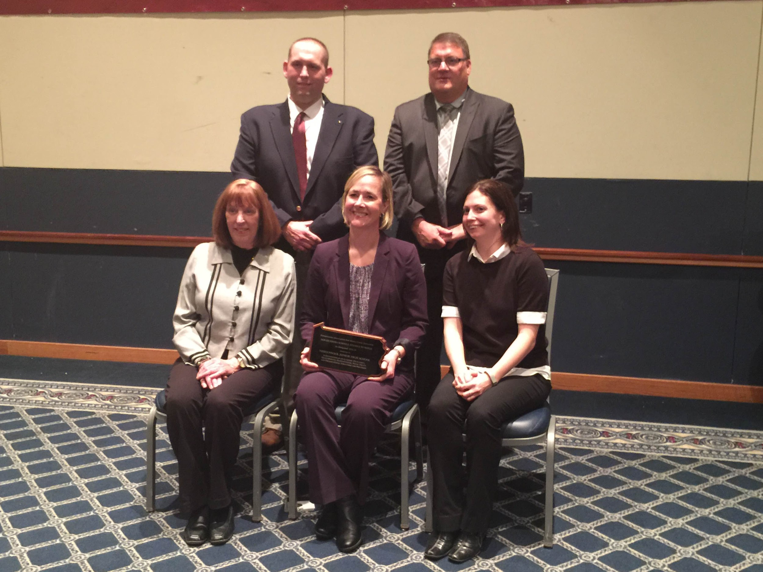
2016 STW Redesignation

Slide 6
Kuder Navigator
Navigator makes planning for the future fun while providing the reliable college and career guidance you can count on.
Middle School Students
Watch videos and read about all of the different careers you can explore.
Quiz yourself about your interests and discover how to connect them to careers.
Get ahead of the game by starting a four-year education plan.
Discover and build a career around your unique interests and skills.
Originally purchased for our District by Lawrence County School-To-Work
Kuder Navigator is a key component of our Act 339 Plan

Slide 7
What is Kuder Navigator and What Can it Do for Your School??

Slide 8
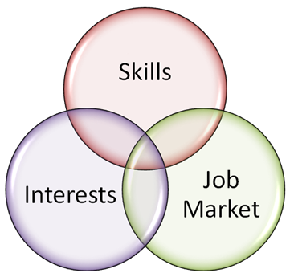
Learn About Myself
Career Skills and Career Interests
Each assessment takes under 20 minutes to complete.
Available in English and Spanish.
Results can be shared via Facebook, Twitter, and email.
Can be started and paused for later completion.
Immediate scoring and reporting for administrators.
Adhere to the latest (2014) technical standards for reliability, validity, and fairness by the Joint Committee: American Psychological Association, National Council on Measurement in Education, and American Educational Research Association.
ASVAB scores can be entered to generate lists of related occupations.

Slide 9
Explore Occupations
Career exploration begins when students discover options that relate to their interests and skills.
Occupations are accessible by assessment results, clusters and pathways, job title or keyword.
Occupations can be searched and compared by required education level, cluster, expected job growth, or median salary.
Career videos help students see occupations in action.

Slide 10
Plan for Education
Once students make a tentative career choice, they need to determine education and/or training requirements
Education planner maps courses based on careers and graduation requirements.
Over 7,000 institutions can be searched and compared by cost, majors, and extracurricular activities.

Slide 11
Plan for Work
Before students begin looking for work, they must prepare documents and get ready for interviews.
Easy-to-use document builders help students
Occupations can be searched and compared by required education level, cluster, expected job growth, or median salary.
Career videos help students see occupations in action.

Slide 12
Find a Job
The final step is when students learn techniques to find job opportunities and begin pursing them.
Links to top job search engines and employer profiles.
Job openings cross-indexed with students’ “favorite” occupations.

Slide 13
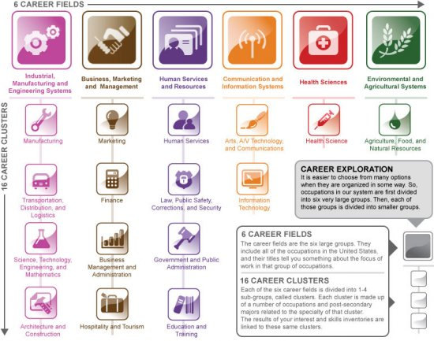
Kuder in the Classroom: Geography
Step # 1: Students sign up for a Kuder Navigator account
Step # 2: Skills test completion
Step # 3: Interest test completion
Step # 4: Examine the 16 career clusters

Slide 14
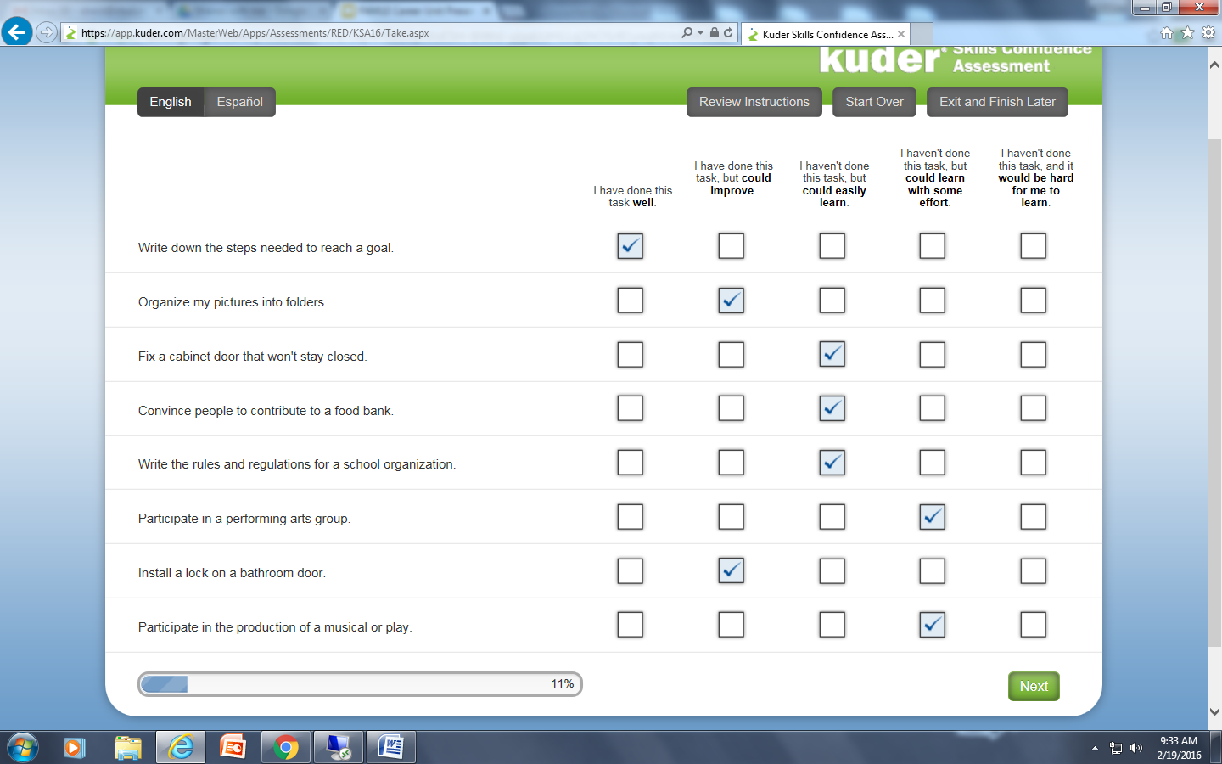
Sample Skills Assessment Questions

Slide 15
Sample Interest Assessment Questions

Slide 16
Results able to be viewed side by side or in a composite.

Slide 17
Kuder in the Classroom: Geography
Interest results for current 7th graders
Skills results for current 7th graders

Slide 18
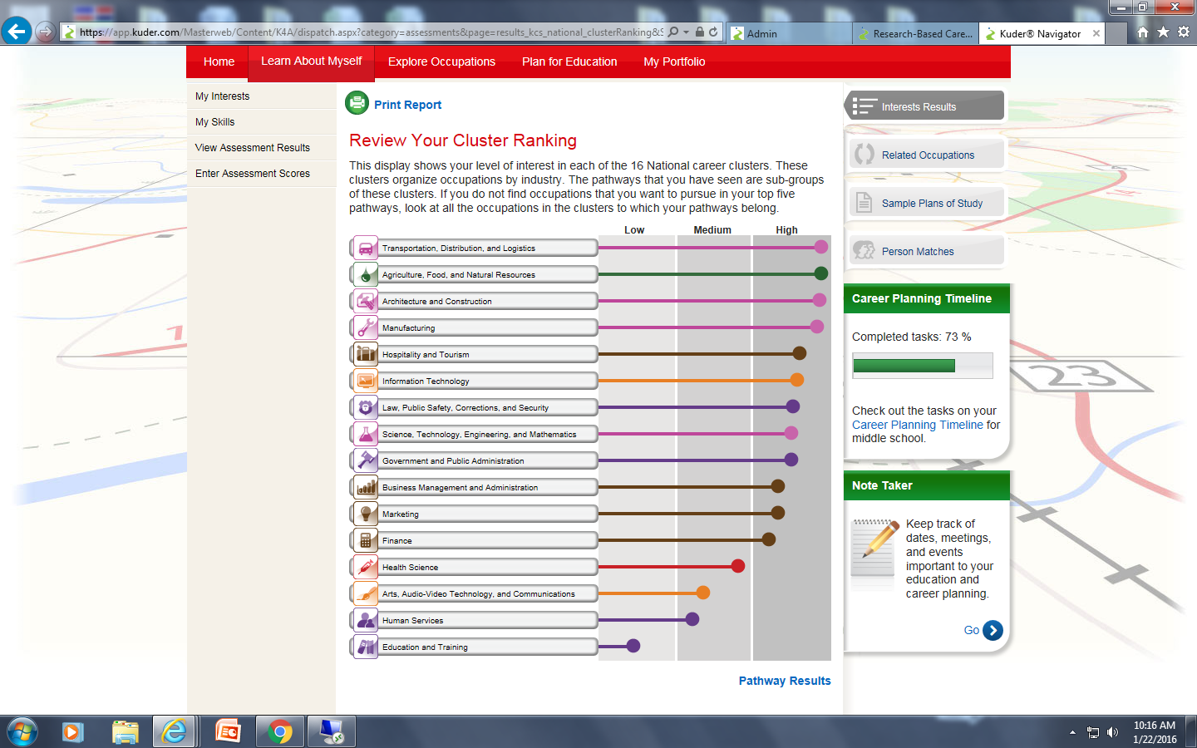
Career Interest sorted by National Career Cluster or by Career Pathway

Slide 19
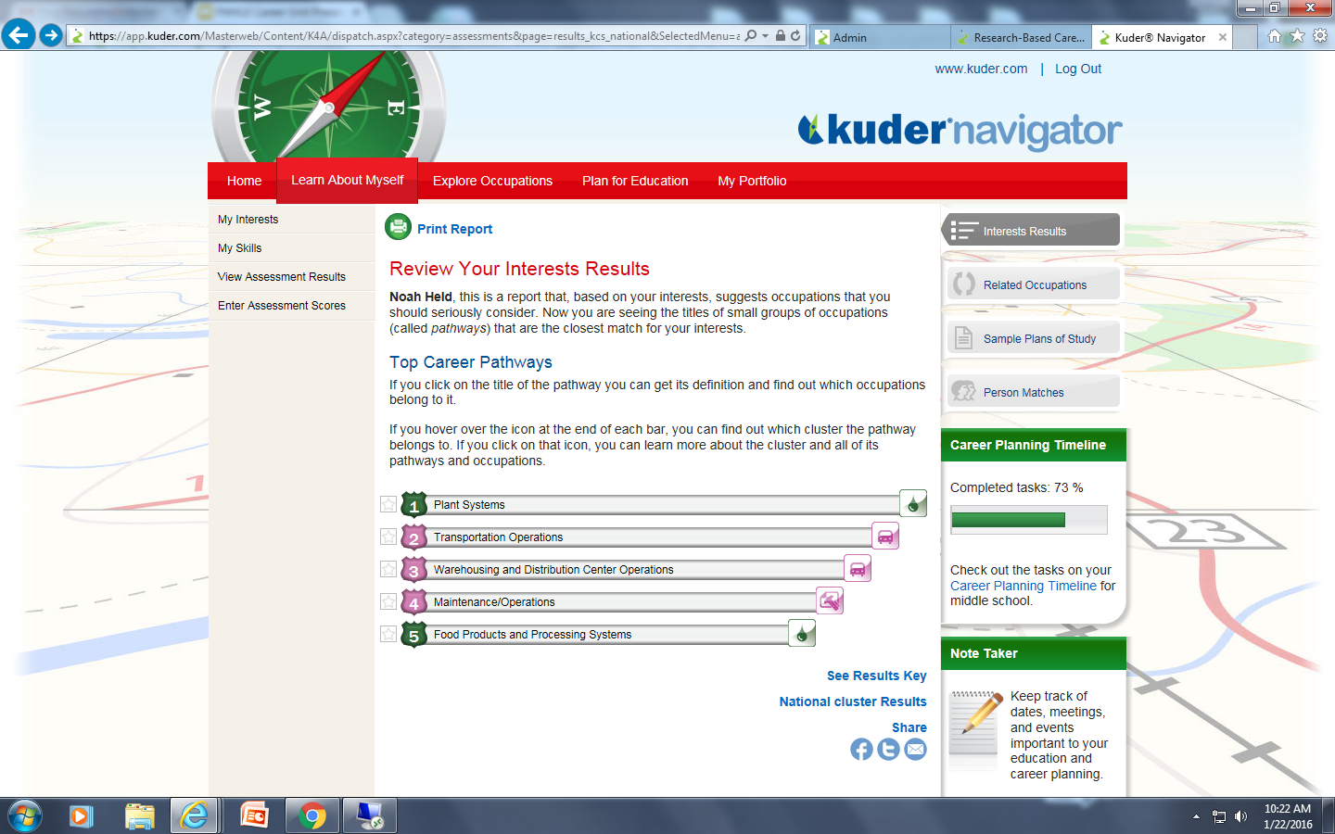
Career Interest sorted by National Career Cluster or by Career Pathway

Slide 20
Pathways within National Clusters

Slide 21
Occupations by level of education required

Slide 22
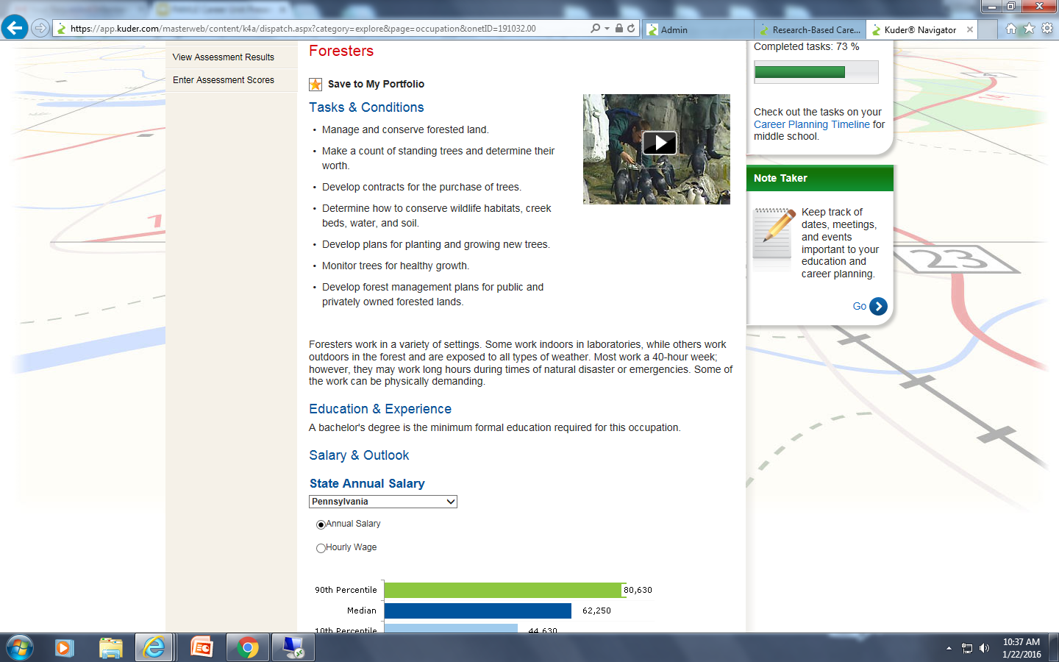
Description of specific occupations including salary information, job tasks
and a brief video showing the type of work that is done.

Slide 23
Example Video from Kuder Navigator

Slide 24
Kuder in the Classroom: English
See packet for handouts used in class!
Step #1: Kuder Lesson 3 Worksheet: choosing/researching careers based on interest
Students complete the worksheet by researching 3 different careers of their choosing
Students complete a title search of careers to explore the site and various careers
Step #2: Explore careers by assessment results
Students choose 2 careers where they have an X in both skills and interest (these results are from the assessment taken in Geography class)
Create an outline of information and write paragraphs for each career using information and statistics from Kuder website
Students then choose 1 of those careers and create a presentation on various aspects of that job that they then give to the class.

Slide 25
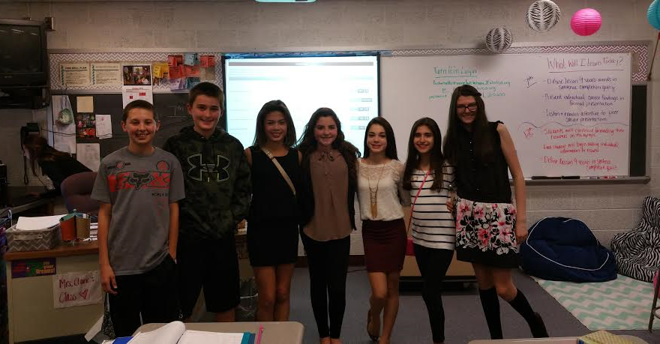
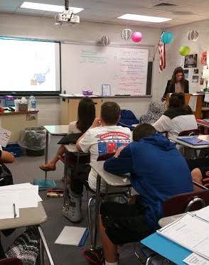
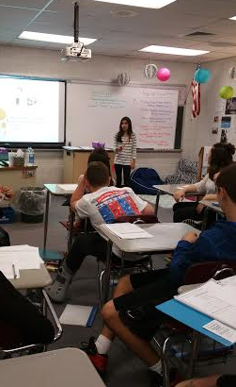
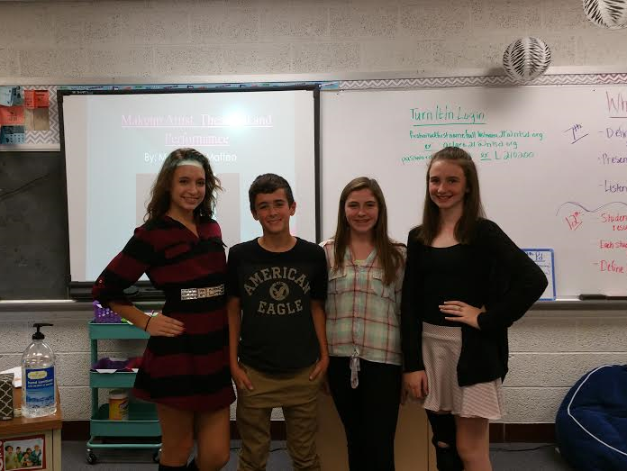
7th Grade Presentations in English Class

Slide 26
Kuder in the 8th Grade
In 8th grade:
Students retake skills/interests tests
Skills and interests are constantly changing!
Students then redo the lesson 3 activity and research 3 new careers based on their personal interests

Slide 27
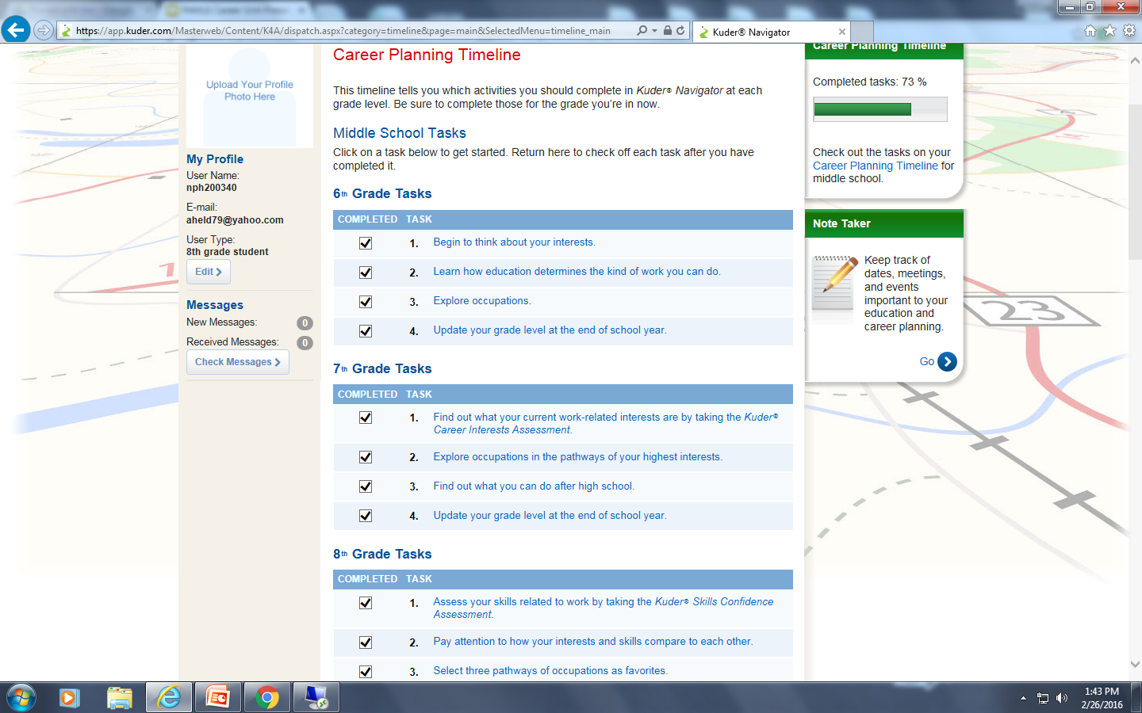
Career Timeline (1 of 2)

Slide 28
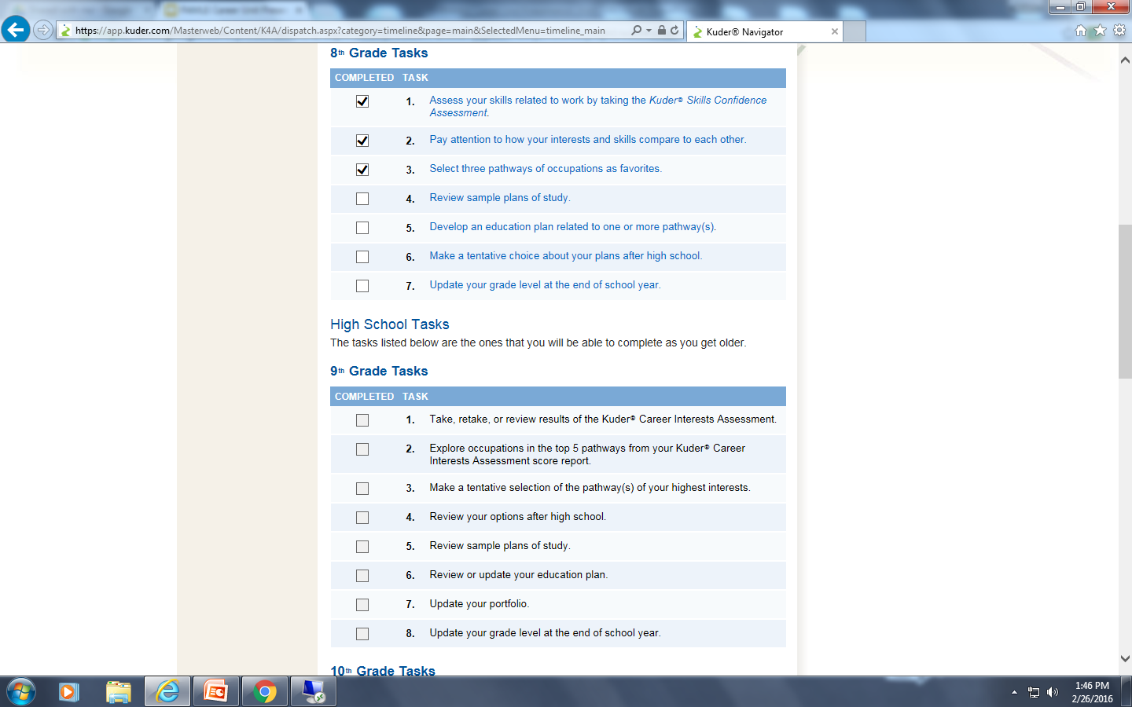
Career Timeline (2 of 2)

Slide 29
Financial Literacy ~ Understanding Money
Keyboarding Applications 8
Career Education ~ The Vault -- Understanding Money
6 learning modules including 2 interactive performance-based games
15-30 minutes each module (cumulative course time 2.5 - 3 hours)
pre- and post-assessment to track knowledge gains in each module
Self-paced interactive program to help students better understand their money
Free, Web-based program through EverFi ~ www.everfi.com

Slide 30
Financial Literacy ~ Understanding Money
Module 1 ~ Responsible Money Choices
Examine trade-offs of saving vs. spending
Module 2 ~ Income and Careers
Explore and evaluate different career options
Wages vs. Salaries
Module 3 ~ Making Plans with Money
Budget your money, Needs vs. Wants

Slide 31
Financial Literacy ~ Understanding Money
Module 4 ~ Credit and Borrowing
Differentiate between buying with cash vs. credit
Module 5 ~ Insurance and Safety
Manage risks, uses and benefits of health insurance
Module 6 ~ Savings and Investing
Different savings, investing, and investment vehicles

Slide 32
Career Fair
Excellent way to involve your community.
Over 100 community members from various professions volunteer to participate.
Held during the school day.
Students choose from 10 different speakers from 10 available sessions.
Half hour sessions.
Doctors, nurses, pavers, welders, gas and oil workers, physical therapists, truck drivers, law enforcement, judges, etc.

Slide 33
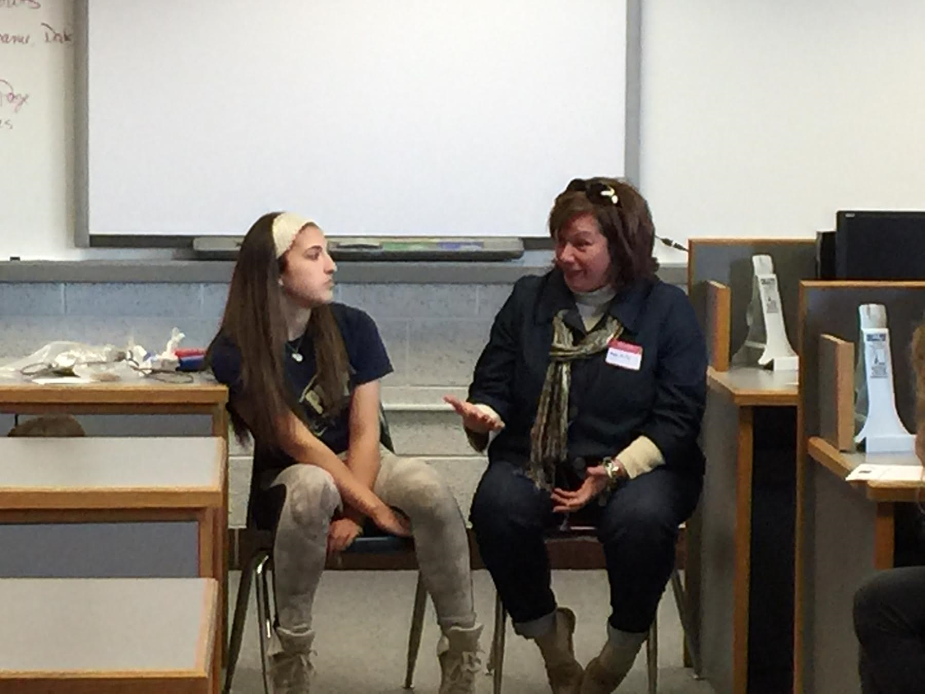
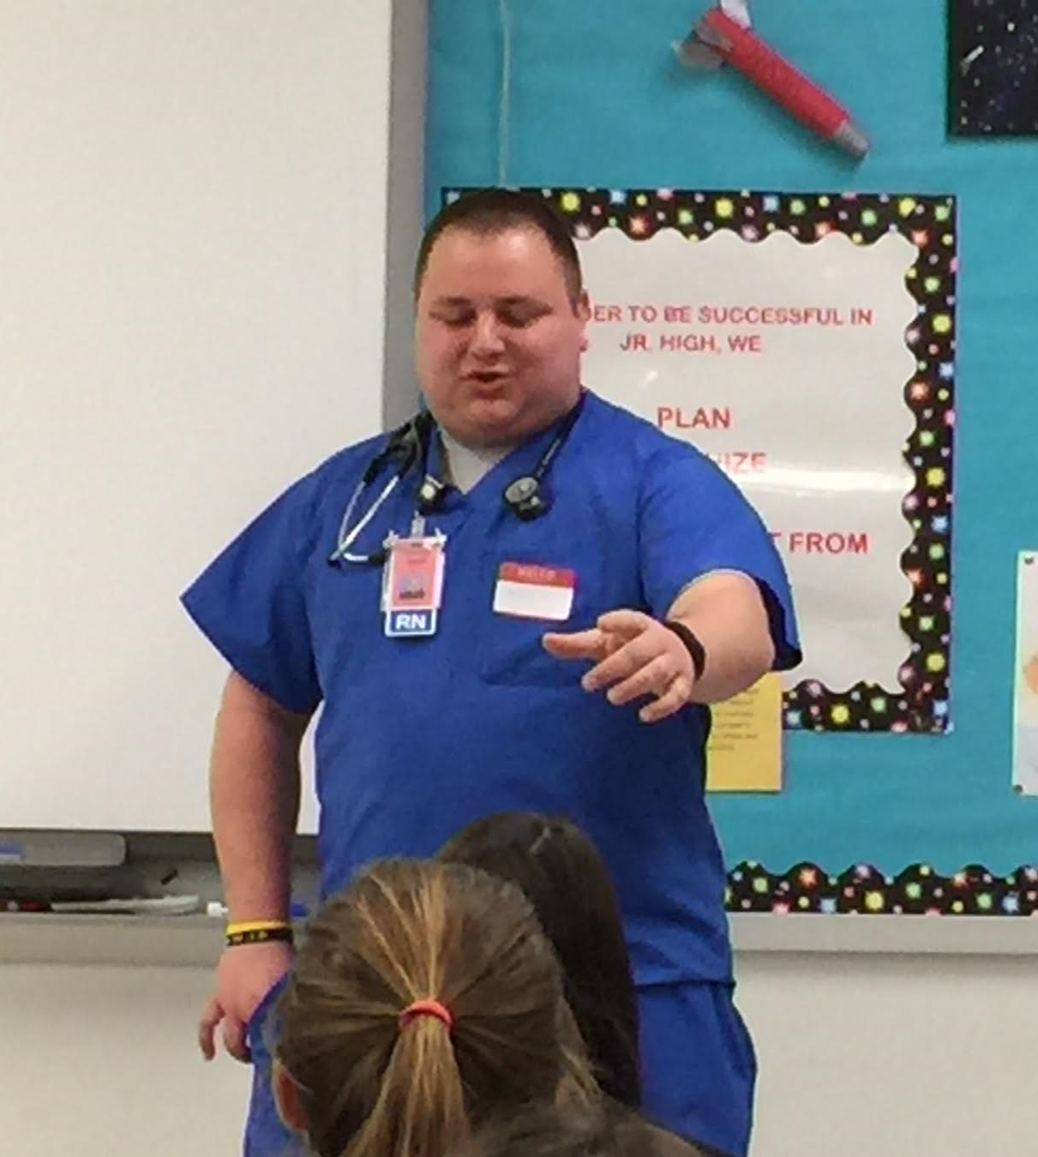
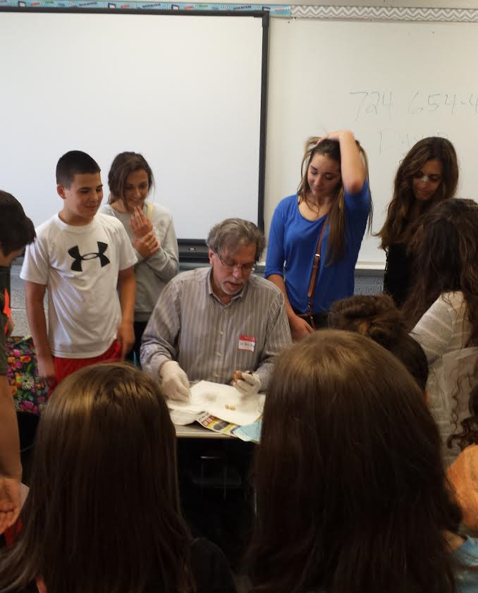
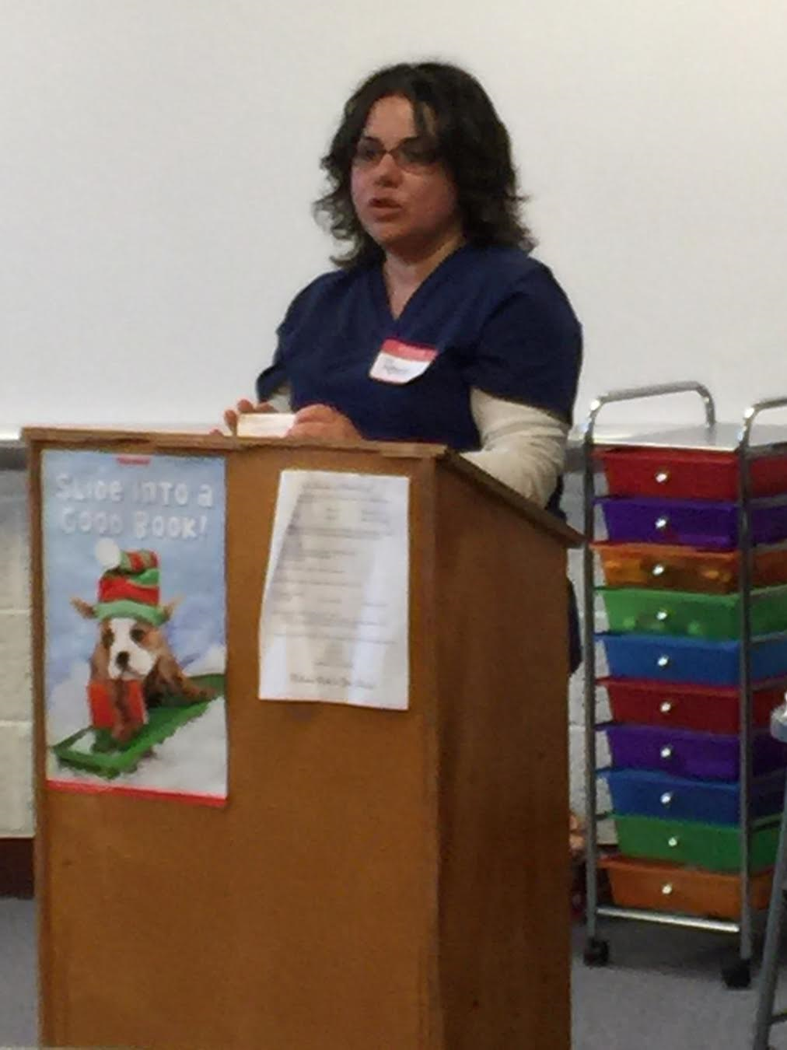
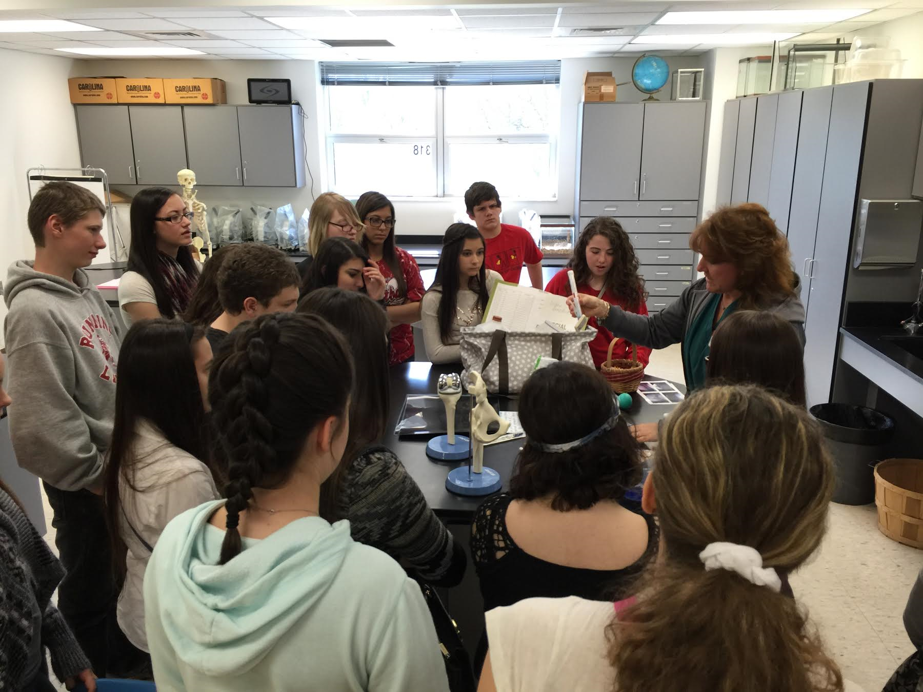
Career Fair Participants - Community is Key!

Slide 34
Where Do We Go From Here?
Careers in our specific content areas
Why our subjects are relevant to our particular careers…
How can we relate topics covered in class to the real world?

